Slide 1
Printon
Imagination to reality.

Slide 2
Problem
Waiting in queue in every printing shop.
Shops are not running 24*7.
Online payment still not available at every shop.

Slide 3
Solution
Online system for Ordering any type of printing .
Receive Order from anywhere ,anytime.
Every system will have payment gateway will administration panel for managing their printing business.

Slide 4



Technology 1.0 (Frontend)
HTML
CSS
Java Script

Slide 5




Technology 2.0 (Backend)
Node.js
MySQL
Mongo DB
JUSPAY

Slide 6
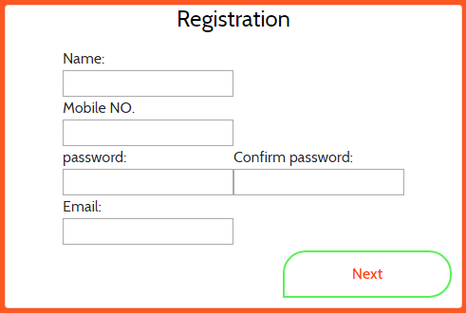
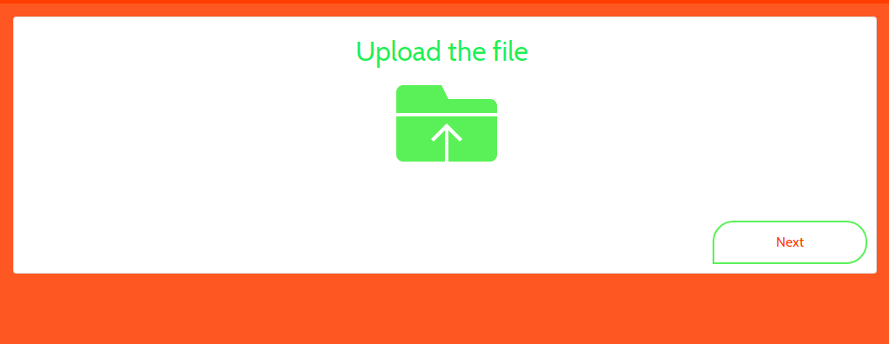
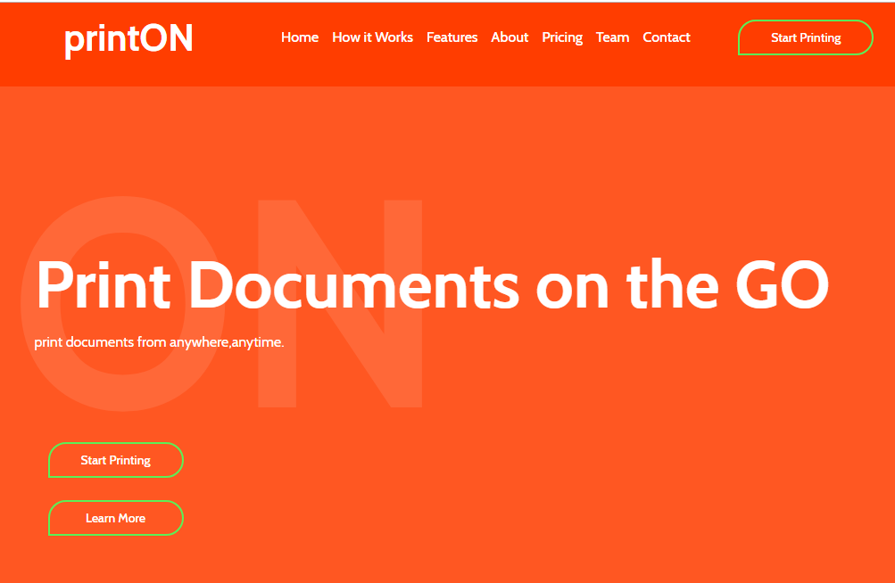
Product
Registration
Upload the File
Get Started

Slide 7
Transaction Cycle
Registration or login
Choose payment and Delivery
Get delivery
Digital signature for completing the order
Upload File

Slide 8
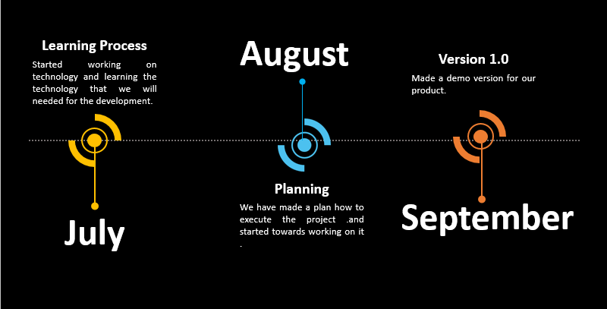
Roadmap

Slide 9
Thank You
Presented By
Smit Sabhadiya(16it111),
Information Technology,
Semester : 5, div :2.
Ankit Shah(16it116),
Information Technology,
Semester : 5, div :2.

